Slide 1
[Project Name] Overview
Project Personnel
Mark Chello – 3rd Year Mechanical Engineering Student
Jarod Berbee – 2nd Year Mechanical Engineering Student
Project Purpose
What is the purpose of this project? For example: The purpose of the Stratus Camera Mount Design Project is to conceptualize, design, and analyze a camera mount solution for the Stratus Spacecraft. The Stratus Mission intends to house a FLIR Tau 2 Imager in its structure (3U-Cubesat). As of this semester, it is unclear how the camera will be mounted to the structure and isolated from environmental disturbances. I intend to conceptualize a structural component that will mate the imager to the Stratus Structure.
End-Goal Statement
What is the final result or product that this project is intended to produce by either the end of the semester or major review (i.e. PDR)? By the Stratus PDR, my goal is to provide a complete design proposal, a preliminary structural analysis, and documentation on how the component will interface with the vehicle. I plan on providing (order is relevant):
A document that summarizes the design: its intent, design motivation, implementation, etc.
A complete CAD Model of the proposed solution, including 2D Drawings
Interface Control Document that summarizes how the component will interface with the imager and structure completed preliminary Structural Analysis showing factors of safety and stress concentrations
Etc.

Slide 2
[Project Name] Schedule
DATE | PROPOSED SCHEDULE | ACTUAL SCHEDULE
Week 2 (Mon Jan. 16th – Sun Jan. 22nd)
Week 3 (Mon Jan. 23rd – Sun Jan. 29th)
Week 4 (Mon Jan. 30th – Sun Feb. 5th)
Week 5 (Mon Feb. 6th – Sun Feb. 12th)
Week 6 (Mon Feb. 13th – Sun Feb. 19th)
Week 7 (Mon Feb. 20th – Sun Feb. 26th)
Week 8 (Mon Feb. 27th – Fri Mar. 3rd)
(Sat Mar. 4th – Sun Mar. 12th)
Week 9 (Mon Mar. 13th – Sun Mar. 19th)
Week 10 (Mon Mar. 20th – Sun Mar. 26th)
Week 11 (Mon Mar. 27th – Sun Apr. 2nd)
Week 12 (Mon Apr. 3rd – Fri Apr. 9th)
Week 13 (Mon Apr. 10th – Sun Apr. 16th)
Week 14 (Mon Apr. 17th – Sun Apr. 23rd)
TASK STATUS
ON SCHEDULE | CURRENT PROJECT | BEHIND SCHEDULE

Slide 3
[Project Name] Week [X-1] Goals
What goals were set for this project this past week?
Goal that was set this past week | Yes
Goal that was set this past week | No
Goal that was set this past week | Yes
NOTE THAT THERE IS NOT AN OPTION FOR “PARTIALLY MET”. YOU EITHER FULLY MEET A GOAL OR DON’T MEET IT AT ALL. IT IS NOT NECESSARILY A “BAD” THING YOU DIDN’T MEET A GOAL, YOU JUST NEED TO EXPLAIN IT IN THE FOLLOWING SLIDES!
Project Status
FULLY MET | NOT MET

Slide 4
[Project Name] Progress Update
“Prove” the progress this project has made this past week, “prove” you met this past week’s goal(s), provide any content necessary to get the feedback this project needs to make progress in the coming week, list any questions you have for this project.
Try to have your questions focused around:
Cost
Schedule
Technical

Slide 5
[Project Name] Week [X] Goals
What are the goals for this project in the coming week?
Goal for the coming week
Goal for the coming week
Goal for the coming week

Slide 6

Project Update Slides Advice
Advice for Making High-Quality Project Update Slides
All students should expect that their Project Update Slides will be presented by their Team Leader at the Aerospace Enterprise’s Weekly Project Update Meetings (Management Meetings). The audience for these slides will be the Leadership Team, Dr. King, & in some cases the AFRL or NASA. In many cases, students will not have the opportunity to present their own slides. Thus, it is appropriate to consider Project Update Slides as “portable” or “un-narrated” powerpoint files. This form of communication has many technical flaws, but unfortunately it is used heavily in industry and engineering; so you need to get good at it! The following slides provide an outline of the important features of an effective “portable” presentation.

Slide 7
Project Update Slides Advice
Advice for Making High Quality Project Update Slides
 | Oral Presentation | Portable “Standalone” Presentation
Focus of the audience | Presenter | Slides
Purpose of slides | Describe concepts that are difficult to convey in language and/or emphasize something | Temporary stand-in for formal written document
Text on slide | Very sparse: “less than 8 lines of text with less than 8 words per line” | Prevalent. Use complete sentences.
Notes pane | For the speaker’s eyes only | For the audience. Serves as a surrogate narrator (reader should not need to scroll)
Gratuitous animations | NO | NO
Graphs and figures | Annotated / described orally by presenter | Must be annotated / called-out in print
Presentation media | Projected on screen | Viewed on desktop monitor
Number of slides | As few as possible | As many as necessary
Powerpoint presentations designed for telecons and e-mail distribution are fundamentally different than those designed for oral presentation.

Slide 8
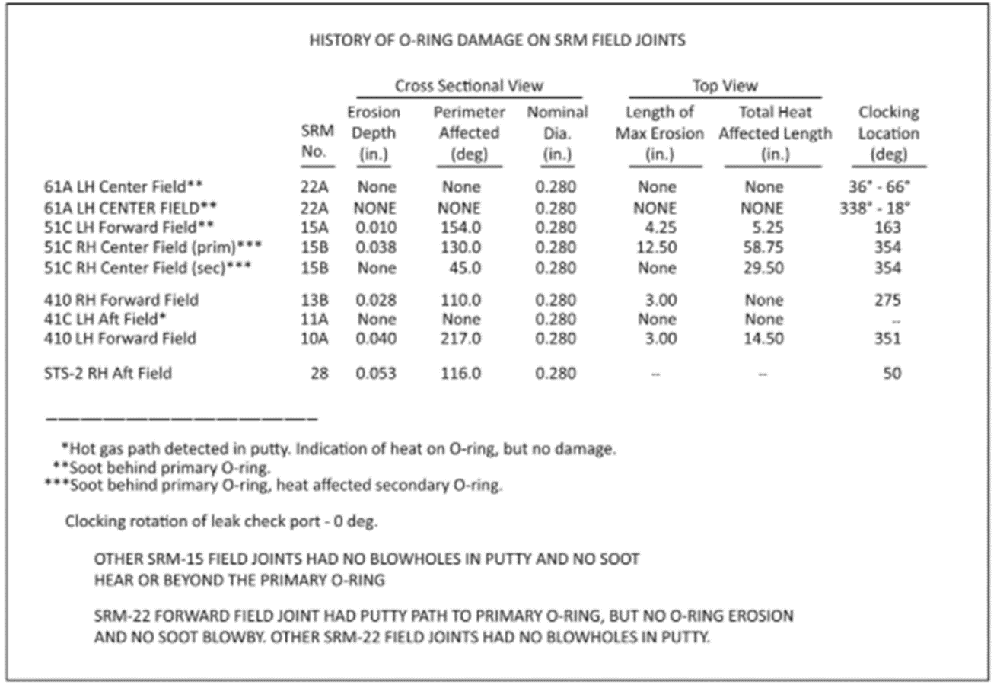
Project Update Slides Advice
Advice for Making High Quality Project Update Slides
The figure above shows a slide from a presentation faxed by Morton-Thiokol to NASA attempting to warn of low-temperature failure risk in o-ring seals prior to Challenger disaster.

Slide 9
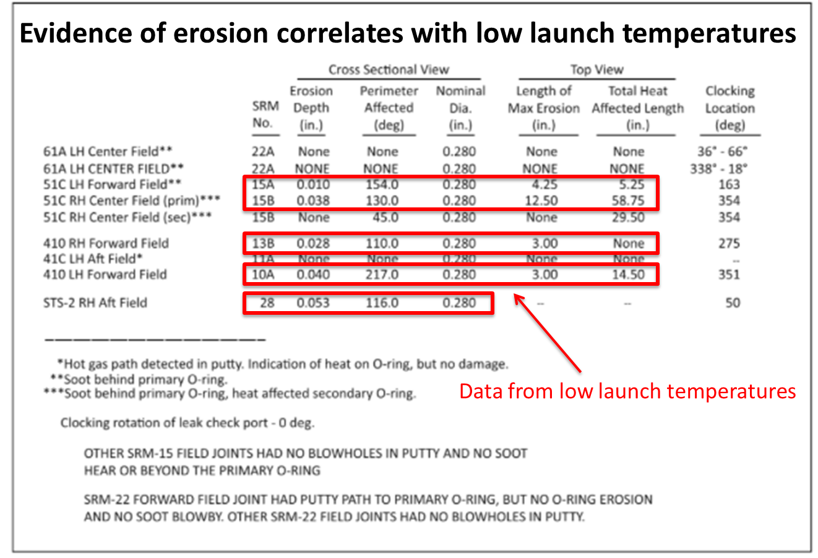
Project Update Slides Advice
Advice for Making High Quality Project Update Slides
This is how that presentation slide should have looked….

Slide 10
Project Update Slides Advice
Advice for Making High Quality Project Update Slides
A slide is analogous to a paragraph: it should have one complete idea, start out with a “topic sentence” and then provide details.
Multiple “paragraphs” that are linked by a common thread (e.g. Description of Procedure) are given a common Heading.
Text space is limited – graphic design is eminently important.
Don’t assume your reader will see what you want him/her to see. Call out the important point(s) with annotation.
Take advantage of the “notes” pane to provide narration. If the narration is critical alert the reader to its presence in the slide (many readers ignore the notes).
Number your slides and label your figures (Figure 1 or Figure 7-1). You can then refer to them in other slides or direct readers to them over the phone.
While completely forbidden in an oral presentation, text-only slides (like this one) are acceptable if used sparingly.

